Slide 1
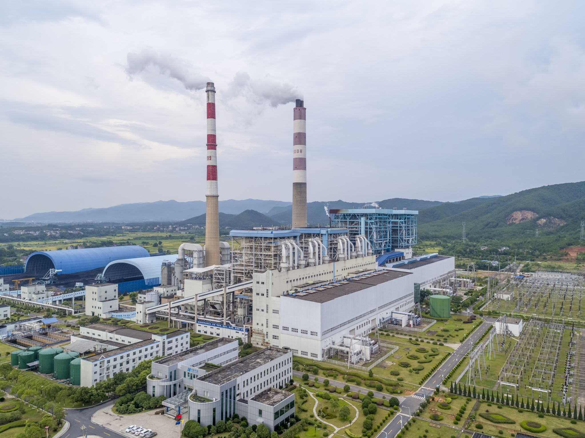
Air Pollution
Dimotiko Scholeio Tseriou 1,
Tseri, Nicosia, Cyprus
2022-1-EL01-KA220-SCH-000085994
“The material of the project reflects only the author’s views. The European Commission’s support for the production of this publication does not constitute an endorsement of the contents which reflects the views only of the authors, and the Commission or the Hellenic National Agency cannot be held responsible for any use which may be made of the information contained therein.”

Slide 2
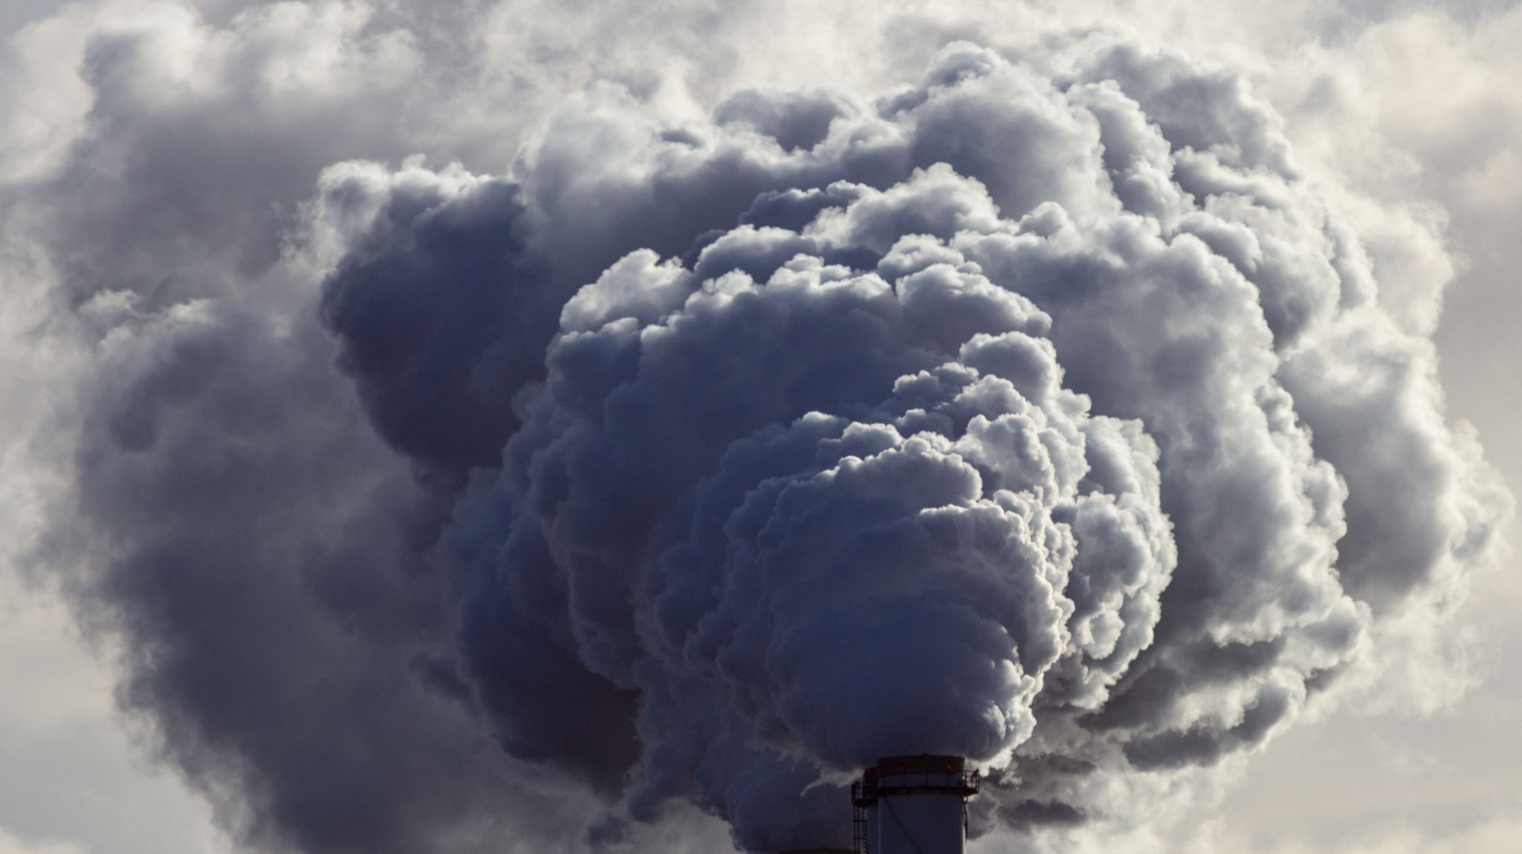
What is air pollution
Air pollution is when harmful substances get into the air we breathe.

Slide 4
Types of air pollution
Some common types of air pollution include:
Particulate Matter: Tiny pieces of dust, dirt, smoke, that float in the air.
Carbon Monoxide: A gas that comes from burning fuels like gasoline.
Sulfur Dioxide: This comes from burning fossil fuels, like coal and oil.
Nitrogen Oxides: These are gases produced when fuels burn, and they can contribute to smog and acid rain.
Ozone: Not the same as the protective layer in the atmosphere! Ground-level ozone is a harmful gas formed by the reaction of sunlight with pollutants.

Slide 5
Air pollution problems
Air pollution can cause a wide range of problems for humans. Here are some of the main issues:
Respiratory Problems: Breathing in polluted air can irritate the lungs and worsen existing respiratory conditions like asthma and bronchitis. It can also lead to shortness of breath, coughing, wheezing and other breathing difficulties as well as allergies and lung cancer.
Cardiovascular Issues: Air pollution has been linked to an increased risk of heart attacks, strokes, and other cardiovascular problems.
Health Impacts on Children: Children are particularly vulnerable to the effects of air pollution because their bodies are still developing. Exposure to polluted air can lead to stunted lung development, increased risk of respiratory infections, and long-term health problems later in life.
Impacts on the Elderly: Older adults are also at higher risk of health problems from air pollution, especially if they have pre-existing conditions such as heart disease or respiratory issues.

Slide 6
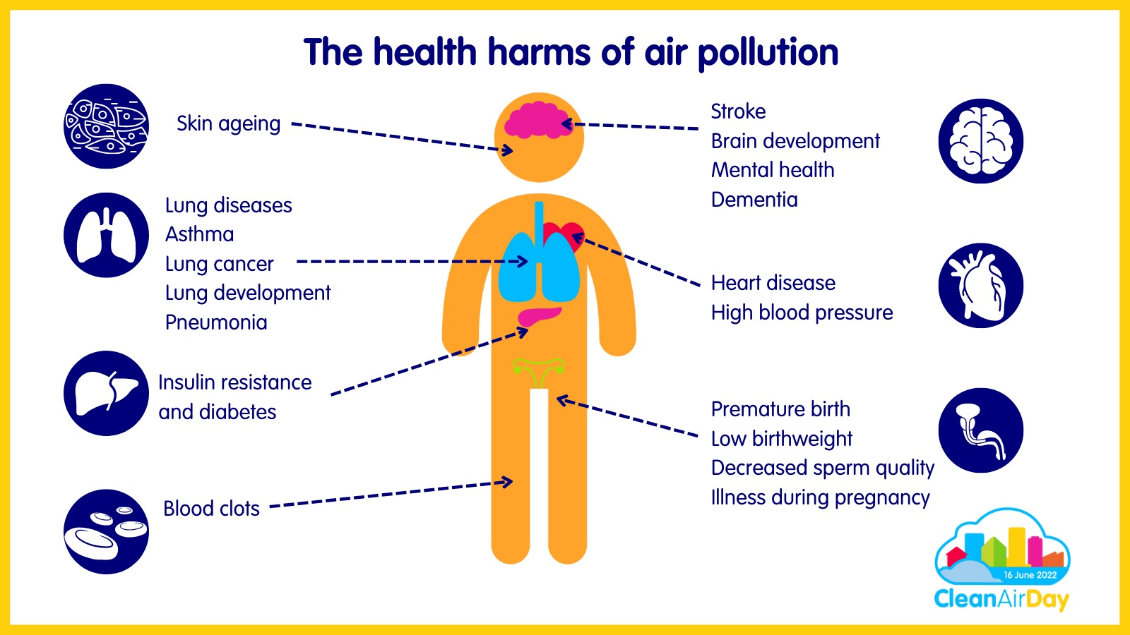

Slide 7
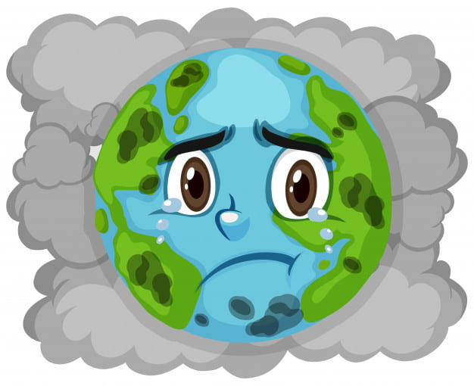
Air pollution problems
Air pollution can cause a wide range of effects on the environment, too. Here are some of the main issues:
Environmental Damage: Air pollution can harm plants, animals, and ecosystems. It can lead to reduced crop yields, damage to forests and waterways, and loss of biodiversity. Polluted air can also contribute to acid rain, which can damage soil, water, and buildings.
Climate Change: Some air pollutants, like carbon dioxide and methane, are greenhouse gases that contribute to climate change. By trapping heat in the atmosphere, these pollutants can lead to rising temperatures, melting ice caps, and more extreme weather events.

Slide 8
How to reduce air pollution
There are several things we can do to help reduce air pollution and protect the environment. Here are some actions individuals, communities, and governments can take:
Use Clean Energy: Choose renewable energy sources like solar, wind, and hydroelectric power instead of fossil fuels like coal and oil. Using clean energy reduces greenhouse gas emissions and air pollution from power plants.
Drive Less: Whenever possible, walk, bike, carpool, or use public transportation instead of driving alone in a car. Vehicles are a major source of air pollution, especially in urban areas, so reducing the number of cars on the road can help improve air quality.
Choose Clean Transportation: If you need to drive, choose vehicles with higher fuel efficiency or low-emission options like electric or hybrid cars. Keep your car well-maintained to reduce emissions, and avoid idling whenever possible.

Slide 9
How to reduce air pollution
Reduce, Reuse, Recycle: Reduce waste and pollution by using less disposable plastic and packaging, and recycling materials like paper, glass, and metal. This reduces the need for new resources and reduces pollution from manufacturing and disposal processes.
Conserve Energy: Use energy-efficient appliances, LED light bulbs, and smart thermostats to reduce energy consumption and lower emissions from power plants. Turn off lights and electronics when they're not in use, and adjust your thermostat to save energy.

Slide 10
How to reduce air pollution
Support Clean Air Policies: Advocate for laws and regulations that reduce air pollution and promote clean energy, transportation, and industry practices. Support initiatives to improve air quality in your community and around the world.
Plant Trees and Gardens: Trees and plants help absorb air pollutants and improve air quality. Planting trees and creating green spaces in urban areas can help reduce pollution and provide other environmental benefits like shade, habitat for wildlife, and cooling effects.
Educate Others: Spread awareness about the importance of air quality and the actions we can take to reduce air pollution. Encourage others to make environmentally friendly choices and support efforts to protect the air we breathe.

Slide 11
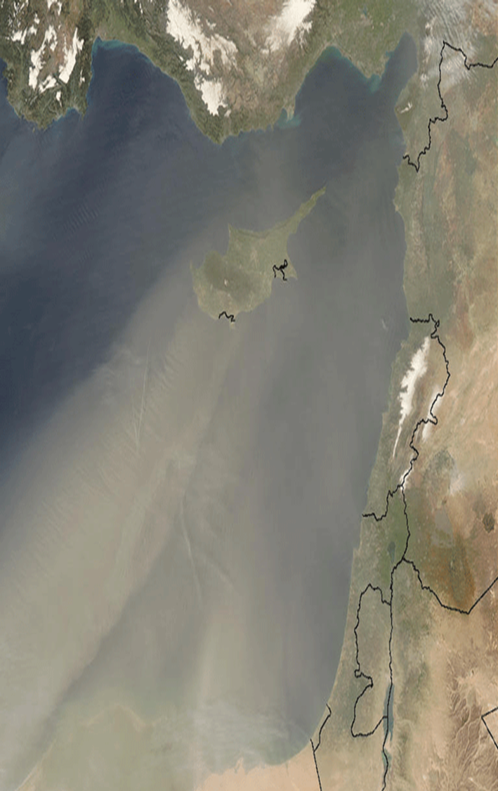
Air pollution in cyprus
Cyprus, like many other countries, faces challenges related to air pollution. While Cyprus generally enjoys good air quality compared to some heavily industrialized regions, it still experiences pollution from various sources, including transportation, industry, agriculture, and natural factors.
Traffic Emissions: The use of cars, trucks, and other vehicles contributes significantly to air pollution in urban areas, especially during rush hours and in densely populated areas like Nicosia, Limassol, and Larnaca.
Industrial Activities: Industrial processes, including manufacturing, construction, and energy production, also contribute to air pollution in Cyprus. Emissions from factories, power plants, and construction sites can release pollutants such as sulfur dioxide, carbon monoxide, and heavy metals into the air, impacting both local air quality and regional environmental health.

Slide 12
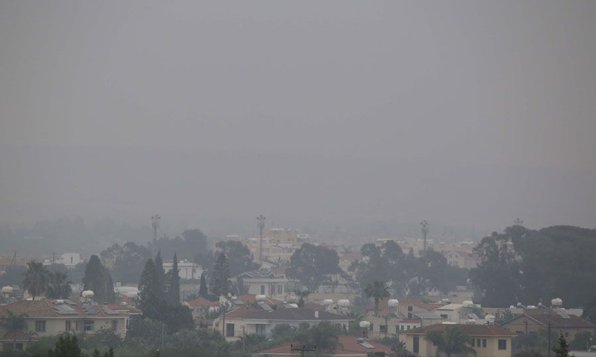
Air pollution in cyprus
Agricultural Practices: Agricultural activities, including crop cultivation, livestock farming, and pesticide use, can also contribute to air pollution in Cyprus.
Topography and Weather Conditions: Cyprus's geographical location and topography can influence air pollution patterns. For example, air pollutants may become trapped in valleys or low-lying areas, leading to localized pollution hotspots. Weather conditions, such as temperature inversions or stagnant air masses, can also exacerbate air pollution by trapping pollutants near the ground.

Slide 13
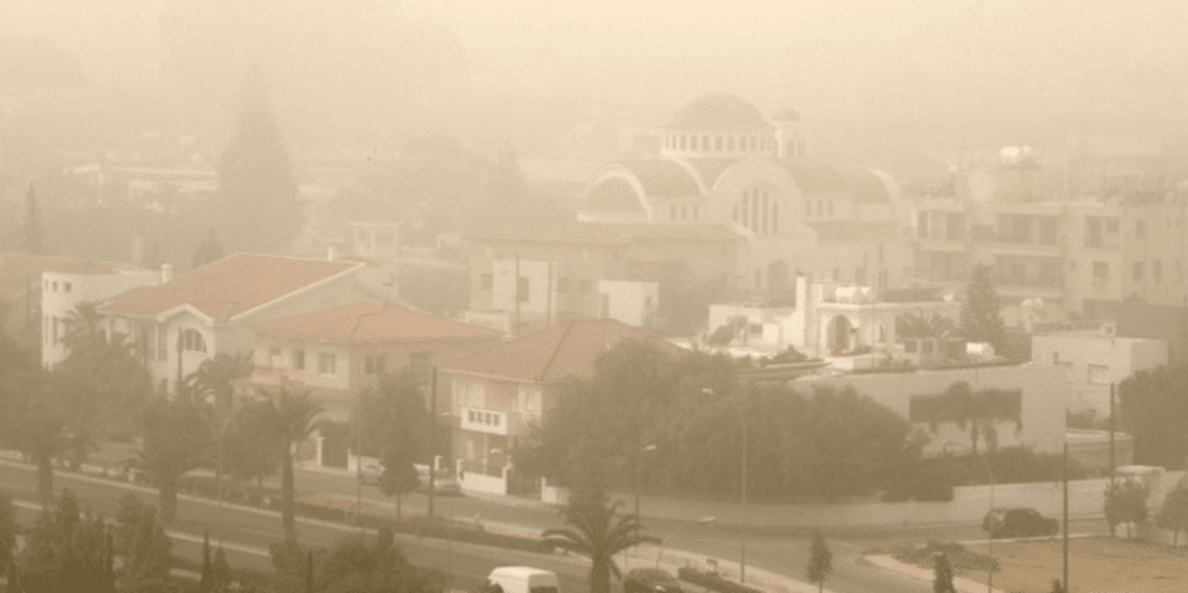
Air pollution in cyprus
Natural Factors: Natural sources of air pollution, such as dust storms, wildfires, and volcanic eruptions, can also impact air quality in Cyprus. Dust storms originating from nearby deserts or dry regions can transport large quantities of particulate matter and other pollutants, leading to temporary spikes in air pollution levels.

Slide 14
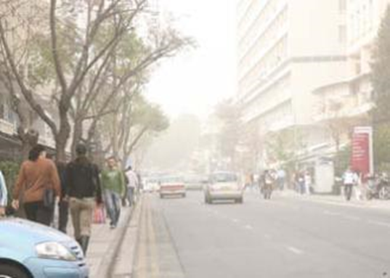
RECOMMENTATIONS DURING A DUST EPISODE in cyprus
The public and especially vulnerable population groups (children, the elderly and the sick) should avoid moving in open spaces until the phenomenon has passed.
Workers in open spaces must use appropriate means of personal protection (e.g. masks, special glasses).

Slide 15
Posters about air pollution created from students of grade 6
BE A PART OF
THE SOLUTION
NOT A PART OF
THE POLLUTION

